Slide 1
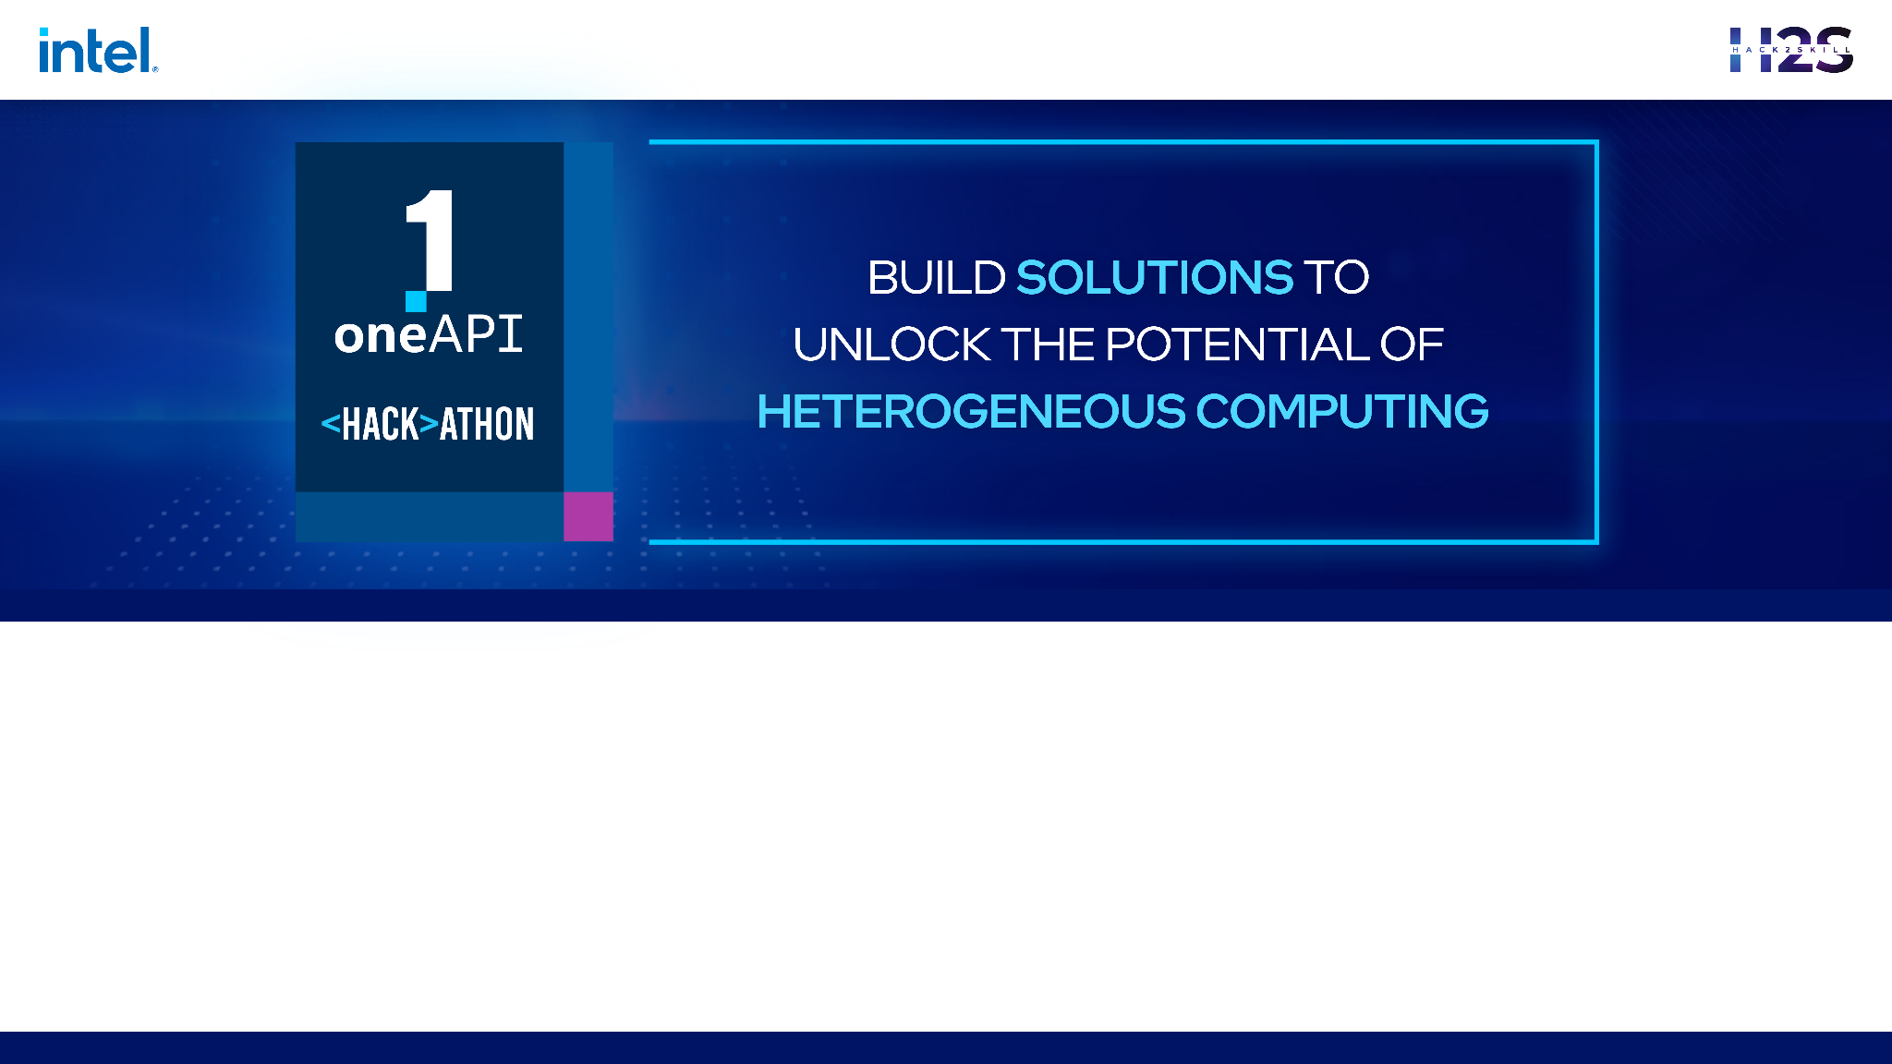
oneAPI_ODAV - oneAPI
Team Name : Hitaya
Team Members : Jayita Bhattacharyya, Arnab Das, Sayan Sinha, Subhasish Dutta

Slide 2

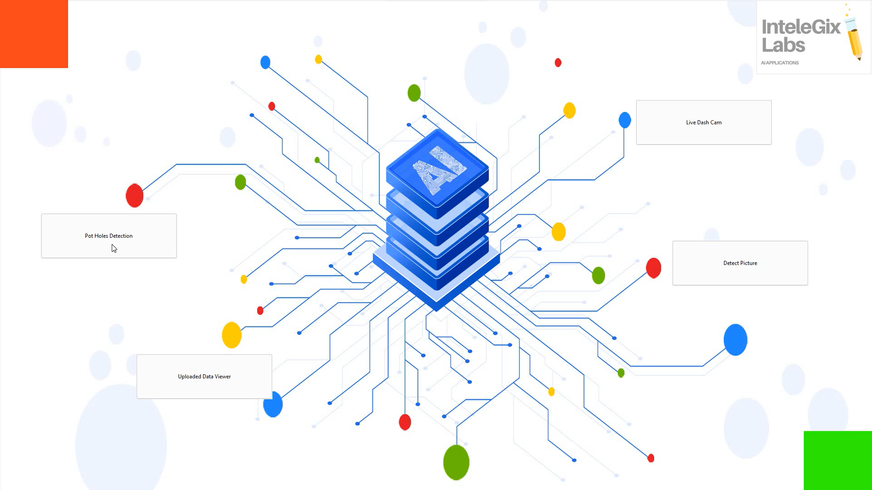
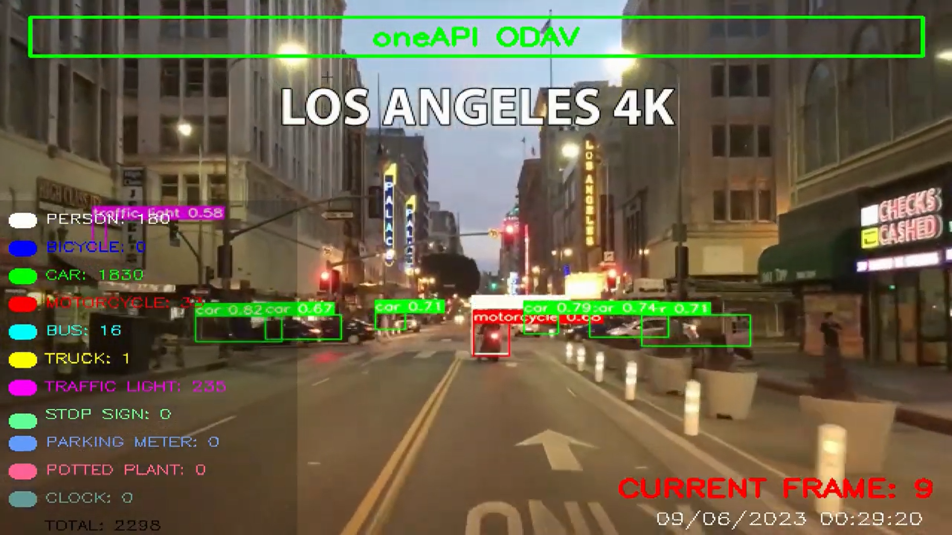

Problem Statement - Object Detection For Autonomous Vehicles
A real-time object detection model for autonomous vehicles using computer vision techniques and Intel® AI Analytics Toolkits its libraries, and SYCL/DPC++ Libraries. To create a deep learning model that can accurately detect objects such as pedestrians, vehicles, traffic signs, and traffic signals. The model should perform with high accuracy and low latency, ensuring safe navigation for autonomous vehicles.

Slide 3
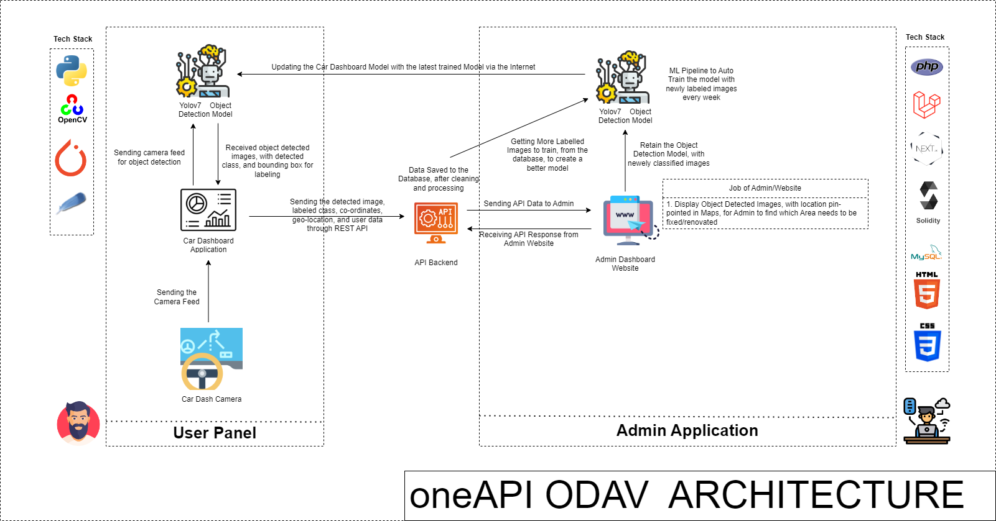
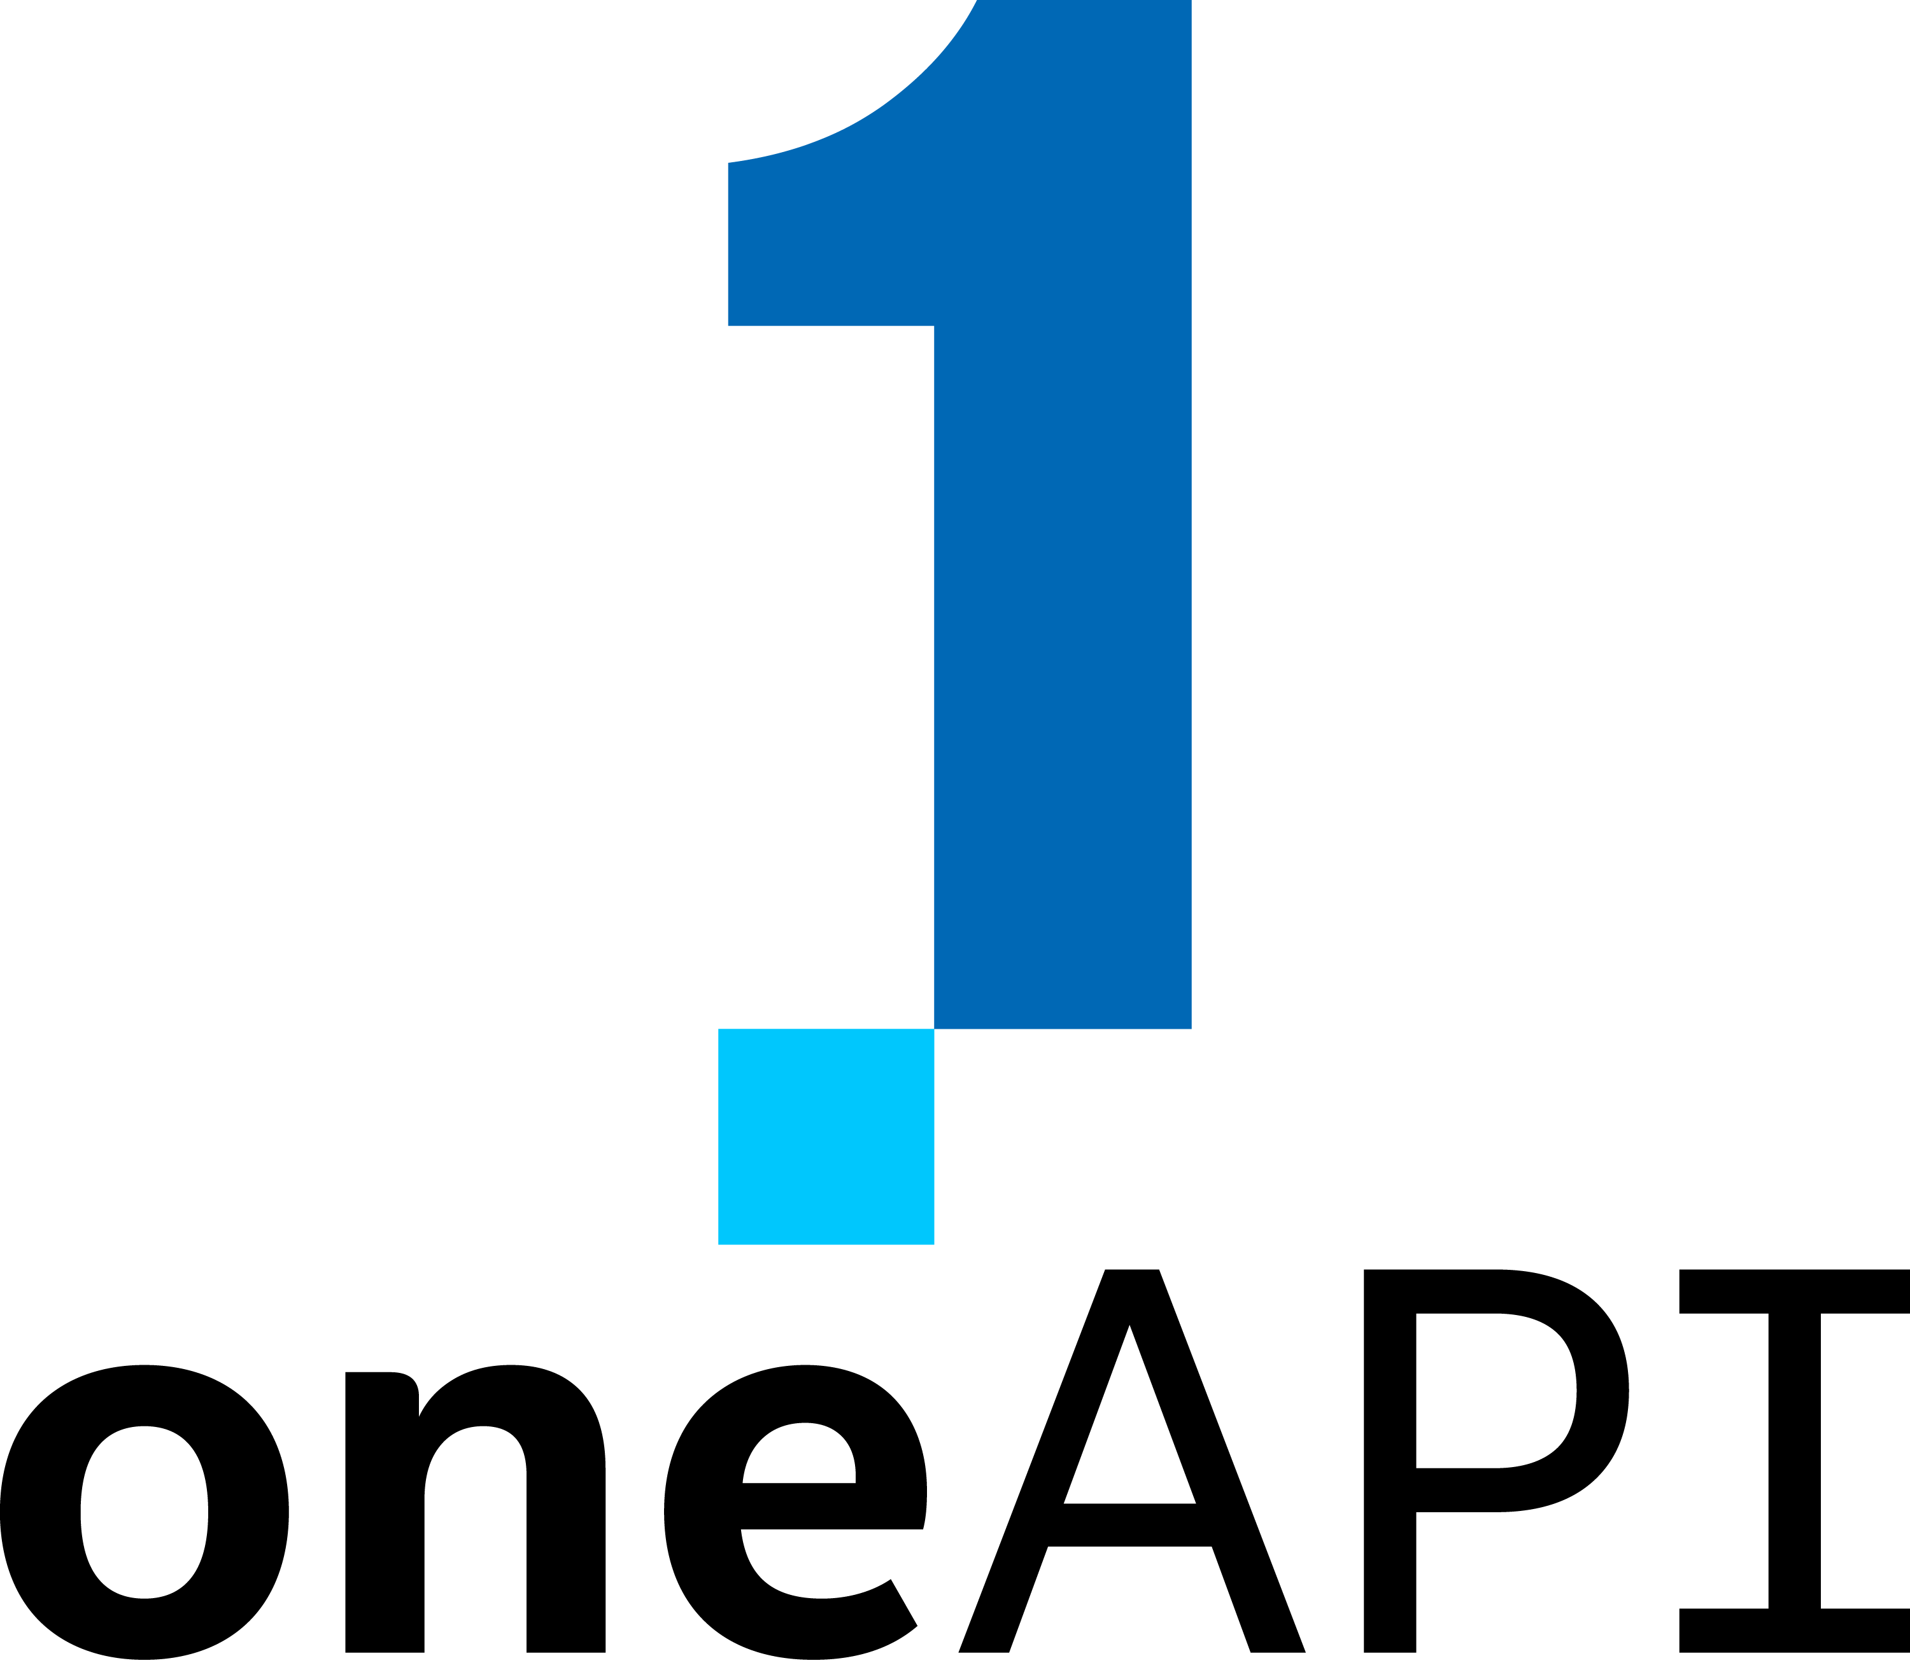
Architecture – Impact of oneAPI/SYCL (How oneAPI /SYCL helped you?)

Slide 4
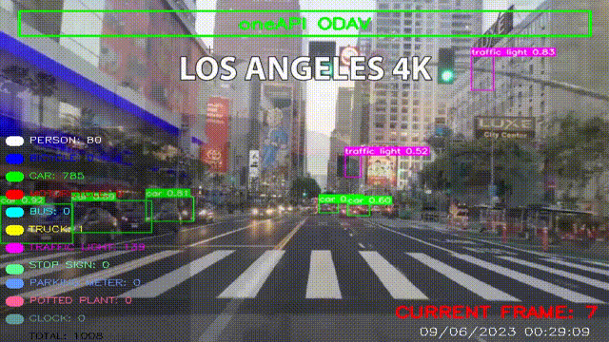
Demo Video/Live Demo
Please elaborate oneAPI/SYCL usage

Slide 5
Core components of oneAPI used in the project
Intel® Optimization for PyTorch
Intel® Distribution for Python
Intel® Distribution of Modin (For Data Analysis)
How is helps us?
Model training and performance got significant boost after training it using Intel Dev cloud using Jupyter Notebook.
We can train on a huge dataset at the same time, by using Dev cloud.

Slide 6
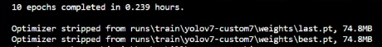
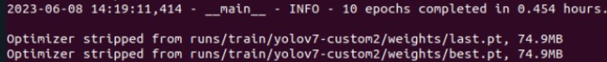
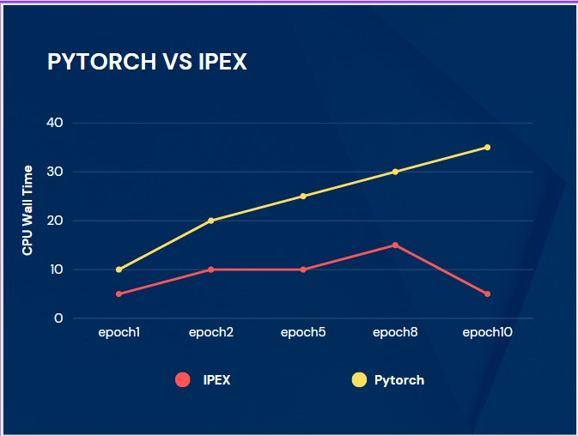
Results Summary
With OneAPI Without OneAPI
Model gains almost 1.5x faster performance training optimized speed with IPEX (Intel Optimization for PyTorch)
CPU Wall time shows comparison in each epoch.

Slide 7
GitHub Link
Codebase Link - https://github.com/jayita13/oneAPI_ODAV
Working Demo Video - https://www.youtube.com/watch?v=aCLAOy6iWAs

Slide 8
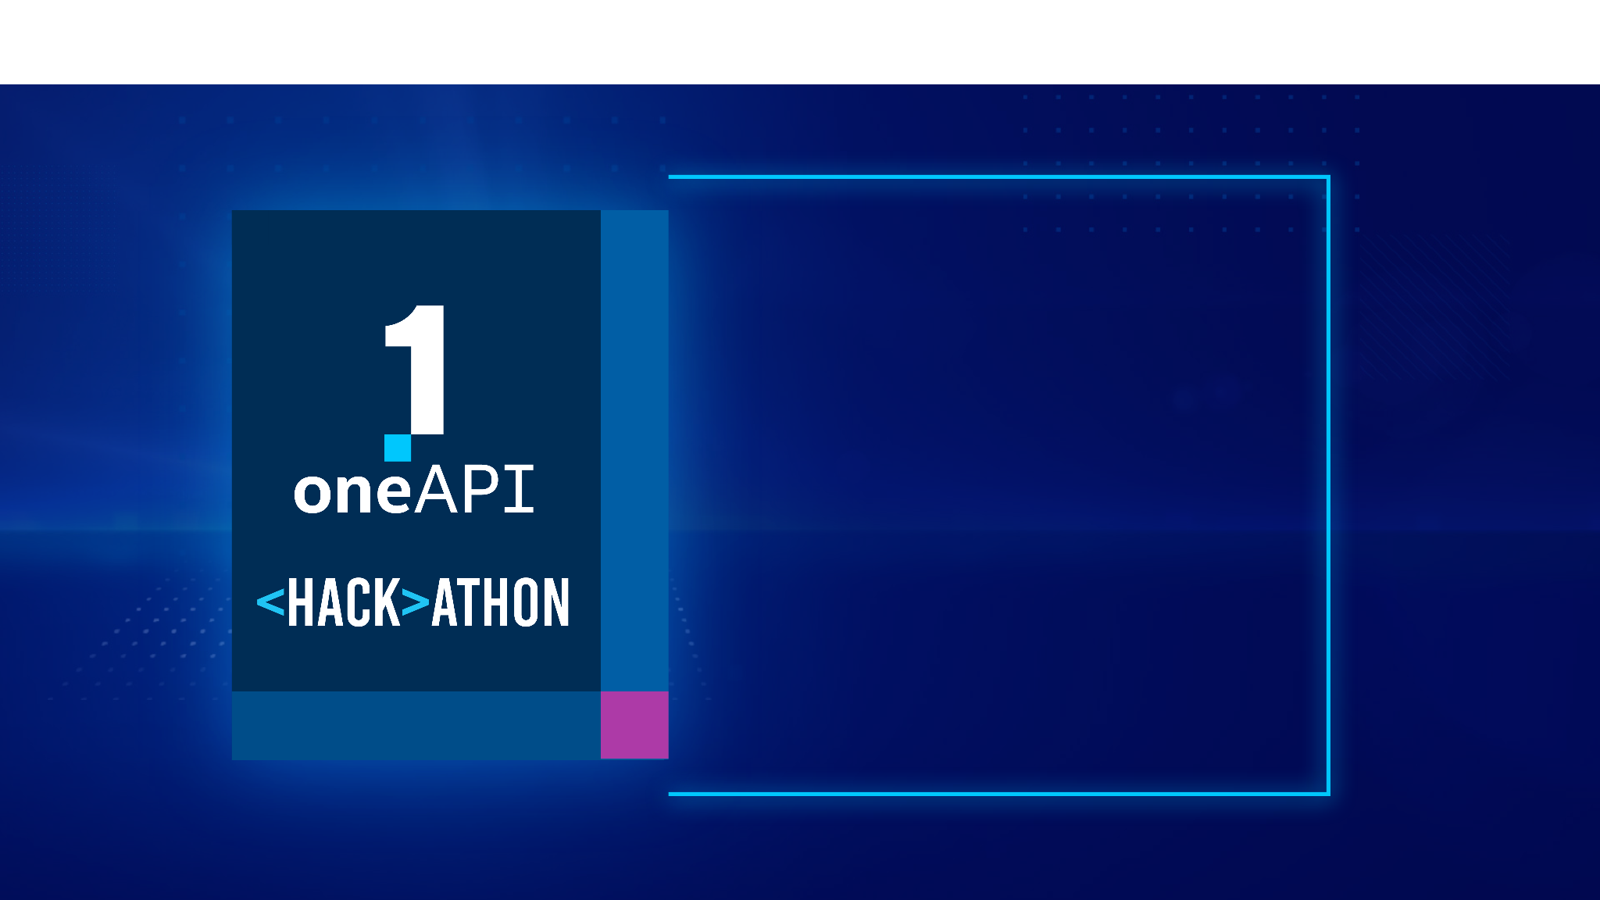
THANK YOU

